Slide 1
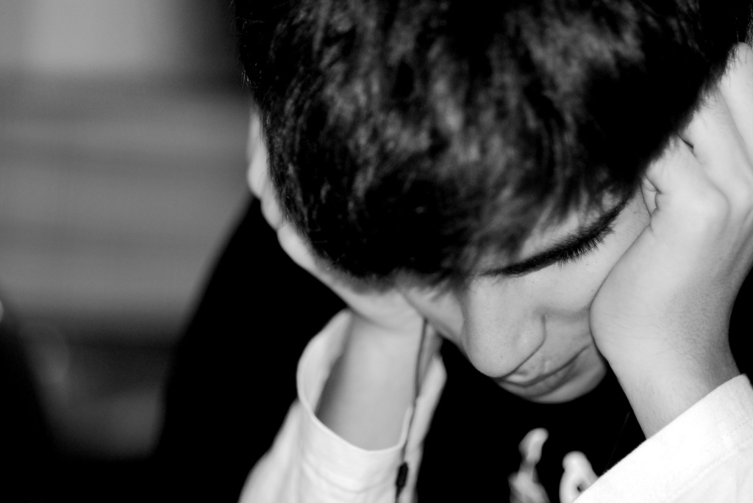

Anxiety and Related Disorders
[Instructor Name]
[Class and Section number]
Notes:
The anxiety module would be best spread out over two class sessions.
Technical Note: These slides may contain simple click animation so that you can focus students’ attention on a particular question, a selection of text, or an image and not have them be distracted by reading ahead. You can either preview the sequence of animation by going through the slides in slideshow view, visiting the animations tab, or reviewing the slide notes. In the notes you will see a cue - (Click) – that corresponds to each animation.
You will also find hyperlinks to outside videos at various places in the slides. These hyperlinks are embedded in text and indicated by color and in the notes section.
Discussion/warm-up: Ask students to think of a past situation that caused them a great deal of worry. What did they do to stop or distract themselves from the worry? Let students generate some answers before moving on to introduce adaptive and maladaptive anxiety.

Slide 2
Overview
Overview of Anxiety
Learning and Anxiety
Anxiety Disorders
Treatment
Notes:
This slide provides an overview of the material that will be covered during the lecture.

Slide 3

Overview of Anxiety
Discussion Question:
What is the difference between adaptive and maladaptive anxiety?
Notes:
This slide encourages students to compare adaptive and maladaptive anxieties.
Discussion question: In what ways can anxiety be helpful?
Possible answers: Students may come up with things like this: Anxiety can motivate us to study for an exam, to go to class, to move away from danger, etc.
(Click) Discussion question: What is the difference between adaptive and maladaptive anxiety?
Answer: Students should produce something like this: Maladaptive anxiety is debilitating or impairs a person’s ability to function while adaptive anxiety helps to motivate us to get things done.

Slide 4
Overview of Anxiety
Triple Vulnerability Model of Anxiety Disorder
  Biological vulnerabilities
  Psychological vulnerabilities
  Specific vulnerability
Notes:
This slide introduces students to three factors that make a person vulnerable to anxiety disorders.
Discussion question: What do you think are some factors that may contribute to a person’s anxiety? (Answers will vary.)
Explanation: A person’s chances of developing an anxiety disorder are increased by what’s called the “Triple Vulnerability Model of Anxiety Disorder.”
(Click) Biological vulnerabilities
Explanation: These are genetic and neurobiological factors that may contribute to a person developing an anxiety disorder.
(Click) Psychological vulnerabilities
Explanation: Our early experiences, including unpredictable stressors or traumatic events, affect our psychological wellbeing and ability to handle stress later in life.
(Click) Specific vulnerability
Explanation: Specific vulnerability shapes the way we deal with anxiety and how it might manifest in different situations based on past experience. For example, one person’s anxiety level may rise when given responsibilities while someone else’s anxiety will grow when they are given free time and left alone.

Slide 5
Overview
Overview of Anxiety
Learning and Anxiety
Anxiety Disorders
Treatment
Notes:
This slide provides an overview of the material that will be covered during the lecture.

Slide 6
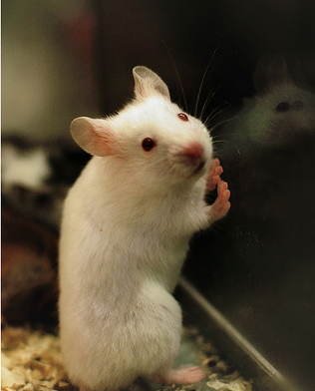
Learning and Anxiety
Fear Conditioning:
Little Albert
Fear of Dogs
  Develop
  Generalize
  Maintain
Notes:
This slide shares the story of Little Albert and discusses the ways anxiety can be learned.
Video: Play the YouTube video about Little Albert that’s linked to the slide. (Students might be interested in discussing the ethical implications of the study they witness in this video, so you might allow that conversation before moving on.)
Discussion question: What ways did fear conditioning occur (e.g., pairing a neutral stimulus with a scary or traumatizing experience)?
Instructor’s note: Point out the importance of learning in the development of all anxiety disorders. We learn what to fear through experience.
(Click) Fear of Dogs
Develop
Discussion: How might a fear of dogs develop (e.g., being bitten)?
(Click) Generalize
Discussion: Ask students to provide examples of what generalization of the fear would look like (e.g., generalize to other dog breeds, dog sizes, and maybe even to all animals).
(Click) Maintain
Discussion: Ask students how a fear of dogs may be maintained (e.g., avoiding dogs, thus creating a lack of positive experiences and avoiding anxiety or an aversive experience).

Slide 7
Overview
Overview of Anxiety
Learning and Anxiety
Anxiety Disorders
Treatment
Notes:
This slide provides an overview of the material that will be covered during the lecture.

Slide 8

Generalized Anxiety Disorder
Worry as a core feature
  Scope
  Persistence
  Effect
Notes:
This slide introduces generalized anxiety disorder (GAD) and the fact that worry is a core feature of GAD.
(Click) Scope
For someone to be diagnosed with GAD, worry must be widespread and undiscriminating. People who experience GAD worry about a wide range of both mundane and serious things.
(Click) Persistence
People with GAD cannot turn off the worry. They worry on more days than not.
(Click) Effect
GAD leads to several impairing symptoms (e.g., sleep difficulties, irritability, etc.).
Note: The image of piglet is listed because he has worry, a core feature of GAD.

Slide 9
A Case Presentation
What symptoms did this patient exhibit?
What types of things did they worry about?
How did the patient’s worry affect her relationships?
How did the patient’s disorder affect their work?
How do you think this patient would be best treated for their disorder?
What do you think the most debilitating part of the disorder is for the patient?
Was there anything surprising about this patient?
Are there any questions about things you feel like you need to know about the patient to properly diagnose and/or treat them?
Notes:
This slide provides the questions for an activity that allows students to step outside of the classroom and apply their burgeoning knowledge of psychological disorders to a case study.
Activity: Learning about Generalized Anxiety Disorder (At least 25 minutes)
Directions:
Show this video of a patient with GAD to the class (8:37 minutes long – also linked to the heading on this slide): https://www.youtube.com/watch?v=3mOkkCkajsI
Randomly assign students into groups of four and give them 10 minutes to work in groups to answer the following prompts on this slide:
What symptoms did this patient exhibit?
What types of things did they worry about?
How did the patient’s worry affect her relationships?
How did the patient’s disorder affect their work?
How do you think this patient would be best treated for their disorder?
What do you think the most debilitating part of the disorder is for the patient?
Was there anything surprising about this patient?
Are there any questions about things you feel like you need to know about the patient to properly diagnose and/or treat them?
Discussion: Have a 5-7 minute guided class discussion, allowing the different groups to present their thoughts to the class.

Slide 10

Panic Disorder (PD)
& Agoraphobia
Physical Sensations
  Near-miss car accident
Difference between adaptive & maladaptive anxiety
Relationship between cues and agoraphobia
Notes:
This slide introduces panic disorder and agoraphobia.
(Click) Physical Sensations
Near-miss car accident
Activity/Discussion: Ask students to close their eyes and imagine being in a near-miss car accident. Then ask them to generate what physical sensations they may be experiencing.
Possible answers: Students may generate things like increased hear rate, increased respiration, sweaty palms, etc.
(Click) Difference between adaptive and maladaptive anxiety
Discussion: Ask students to describe the difference between what adaptive and maladaptive anxiety might look like in the near-miss car accident scenario.
Possible answers: Students may describe panic in the car accident example as adaptive anxiety because our body needs to prepare to take action (e.g., swerve, slam on brakes, etc.).
Video: Show students the first 2 minutes of the YouTube clip of Dan Harris discussing his on-air panic attack. Dan Harris describes this as the “most embarrassing moment of his life”.
Discussion: Ask students what role irrational beliefs play in the development and maintenance of PD. How might cues for a panic attack (maladaptive anxiety) be different from adaptive anxiety felt in a near-miss car accident?
Answer: Students should realize that maladaptive panic symptoms are barely noticeable (e.g., he looks down, stutter, deep breaths), yet people who are experiencing panic feels like everyone knows what they are experiencing. Cues for adaptive panic are life threatening situations whereas cues for maladaptive panic can be external (places that are not inherently dangerous, but where they’ve had previous bad experiences) or internal (physical symptoms).
Discussion: Now that students have an idea of what panic symptoms are like, ask students to consider what it would be like to have those sensations occur at random with no apparent cause or cue. (Answers will vary.)
(Click) Relationship between cures and agoraphobia
Discussion: What types of thoughts would you have if you experienced panic symptoms outside of a dangerous situation (e.g., sitting in class listening to a lecture)? Allow students to describe common thoughts or fears they would have (e.g., dying, going crazy, etc.). Next, the instructor can ask students what they think those thoughts would do to panic symptoms (thoughts end up making the panic symptoms worse).
Explanation: If people develop a fear of experiencing panic symptoms (especially in public or in places where they cannot escape) this is called agoraphobia.
Discussion: Ask students to describe the functional impairment that may arise if people become agoraphobic. Students may generate examples such as avoiding public places, not being able to drive, or not being able to go to work.

Slide 11
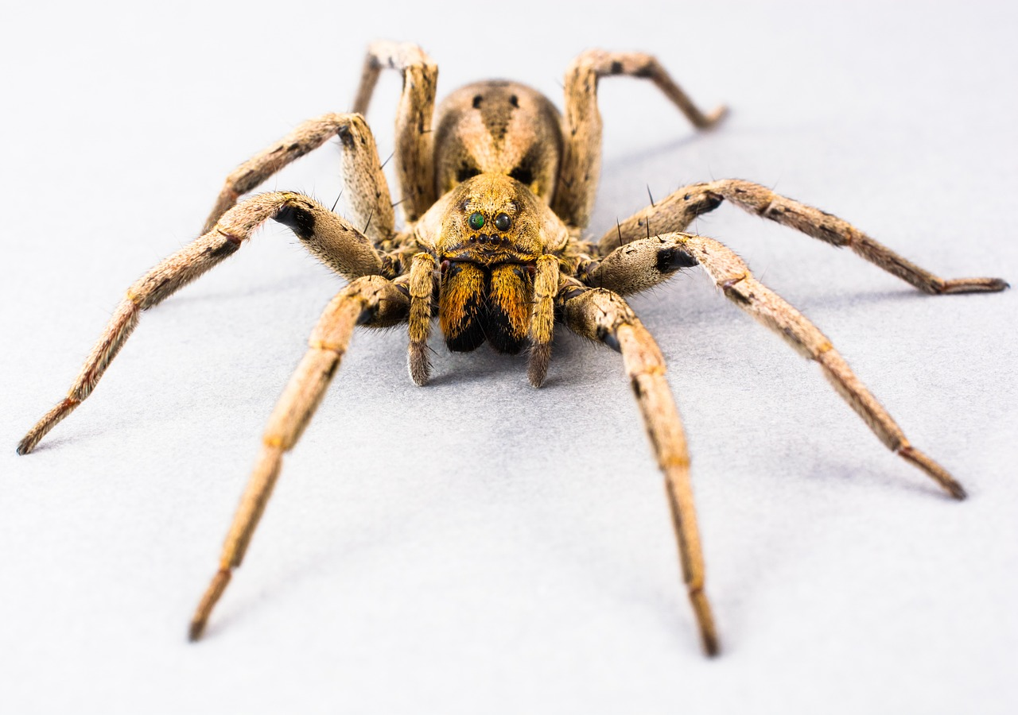
Specific Phobia
Name Those Phobias!
Difference between a fear and a phobia?
Features
  Heritability
  Comorbidity
  Prevalence
Notes:
This slide introduces specific phobias and the difference between fears and phobias.
(Click) Name those phobias!
Discussion questions: What phobias do you know of? (e.g., fear of heights, fear of spiders, fear of blood, etc.)
(Click) What’s the difference between a fear and a phobia?
Instructor’s note: If students have a difficult time, you may ask students what the difference is between an adaptive and maladaptive fear. Students should get close to the fact that fears are adaptive in that they help us avoid things that are inherently dangerous (e.g., spiders can actually kill us, falling from heights can actually kill us, etc.). Phobias on the other hand impair a person’s functioning (e.g., person cannot leave their home in the morning because they are so afraid of encountering a spider).
(Click) Heritability
Specific phobias are one of the most heritable anxiety disorders.
Discussion question: Why is specific phobia one of the most heritable disorders?
Answer: This may be a difficult question for students to answer, but two big reasons are 1) genetic predisposition to specific phobias, and 2) Lack of positive experiences as children because their parent avoided the area of fear.
(Click) Comorbidity
People with specific phobia typically have more than one specific phobia.
(Click) Prevalence
Approximately 12.5% of the population has had a fear significant enough (or with enough functional impairment) to be considered a phobia.

Slide 12
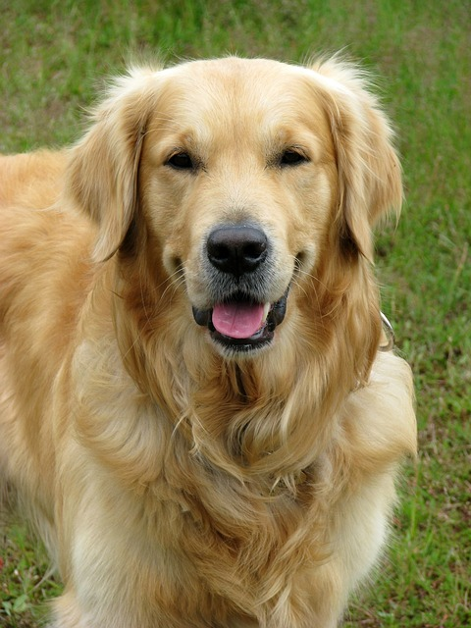
Conditioning & Learning in
Specific Phobia
Bitten by a Golden Retriever at age 4
Fear of dogs
What is the unconditioned stimulus (US)?
Unconditioned response (UR)?
Conditioned stimulus (CS)?
Conditioned response (CR)?
Generalization may contribute to development of dog phobia.
Sweetie
Notes:
This slide helps students apply conditioning and learning principles to the development of specific phobia.
Instructor’s note: Begin by telling a story about a child being bitten by a golden retriever named Sweetie at age 4 causing him/her to have a phobia of all dogs.
(Click) What is the unconditioned stimulus (US)?
Answer: US: Golden Retriever named Sweetie because Sweetie bit the child, causing a reason for fear.
(Click) Unconditioned response (UR)?
Answer: UR: Pain
(Click) Conditioned stimulus (CS)?
Answer: CS: Golden Retriever name Sweetie has now become a conditioned response when the child sees any dog.
(Click) Conditioned response (CR)?
Answer: CR: Fear
(Click) Generalization may contribute to development of a dog phobia.
Discussion question: How might generalization contribute to development of a dog phobia?
Answer: Key points students should aim to include are: 1) People who are afraid of one type of dog may begin to avoid dogs and situations where they are likely to encounter a dog. 2) People are negatively reinforced for avoiding dogs because there is no fear/pain response when people avoid dogs.
Instructor’s note: Point out that a fear of dogs is different than a dog phobia because a dog phobia would need to impair functioning.

Slide 13

Anxiety and Related Disorders
Part 2
Notes:
This slide introduces Part 2 of the Anxiety of Related Disorders module.
Technical Note: These slides may contain simple click animation so that you can focus students’ attention on a particular question, a selection of text, or an image and not have them be distracted by reading ahead. You can either preview the sequence of animation by going through the slides in slideshow view, visiting the animations tab, or reviewing the slide notes. In the notes you will see a cue - (Click) – that corresponds to each animation.
You will also find hyperlinks to outside videos at various places in the slides. These hyperlinks are embedded in text and indicated by color and in the notes section.

Slide 14
Overview
Overview of Anxiety
Learning and Anxiety
Anxiety Disorders
Treatment
Notes:
This slide provides an overview of the material that will be covered during the lecture.

Slide 15
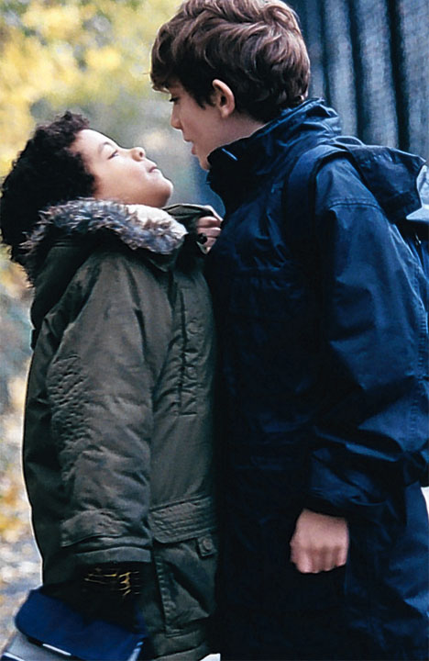
Social Anxiety Disorder (SAD)
Adaptive vs Maladaptive
Role of functional impairment
What role do social experiences play in the development of SAD?
Notes:
This slide helps students distinguish between adaptive and maladaptive anxiety in relation to social anxiety.
(Click) Adaptive vs Maladaptive
Discussion: Ask students to imagine coming in late to class and the reactions they might have. Ask them why they felt that way and if they think this is a “normal” reaction? Ask them to provide opinions on when they think these kinds reactions might become maladaptive.
Possible answers: Students will likely volunteer answers like, “It was embarrassing” or they might blush, etc. They may indicate that they violated a social norm (e.g., came in late when others arrived on time) and that the majority of people would experience the same feelings of embarrassment in the situation. These reactions might become maladaptive if they were unable to come to class at all due to the anxiety associated with coming in late.
(Click) Role of functional impairment
Discussion question: What types of situations do people who are socially anxious avoid? What’s the purpose or role of avoiding these situations?
Possible answers: Students may say “high-risk” social situations (e.g., fear of dates, fear of rejection, and fear of embarrassment). Though it is adaptive to dislike feeling embarrassed, people with SAD likely avoid situations where embarrassment could occur (e.g., may avoid school because they could be late to class, etc.) to ensure that they never have to encounter that negative feeling. This leads to impairment in functioning.
(Click) What role do social experiences play in the development of SAD?
Answer: There’s a relationship between bullying or repetitive extremely embarrassing situations and SAD. Essentially, SAD is a learned behavior that’s reinforced by internal and external stimuli.

Slide 16
Posttraumatic Stress Disorder
(PTSD)
Symptoms
Discussion
How are some of the symptoms of PTSD adaptive in combat zones?
When do symptoms become maladaptive?
Re-experiencing
  Flashbacks
  Nightmares
  Thoughts
Avoidance
  Places
  Feelings
Hyperarousal
  Exaggerated startle reflex
  “On edge”
  Difficulty sleeping
Notes:
This slide focuses on the symptoms and effects of PTSD.
Instructor’s note: Introduce this slide by describing how PTSD develops following exposure to trauma. Be sure to indicate that many who experience trauma do not go on to develop PTSD.
(Click) Symptoms
There are three broad domains of symptoms:
(Click) Re-experiencing
Flashbacks
Nightmares
Thoughts
Explanation: Flashbacks occur when memories are so vivid that they feel like they are being relived. This may cause physical responses like racing heart or sweating. Nightmares about the trauma, and frightening thoughts are other ways that a person with PTSD might re-experience the trauma.
(Click) Avoidance
Places
Feelings
Explanation: People with PTSD avoid places and feelings associated with the trauma. As a result of avoidance people with PTSD may also experience guilt, depression, or worry.
(Click) Hyperarousal
Exaggerated startle reflex
“On edge”
Difficulty sleeping
Explanation: Hyperarousal symptoms may include being easily startled, feeling tense or “on-edge”, and having difficult sleeping and/or having angry outbursts.
(Click) Discussion: How are some of the symptoms of PTSD adaptive in combat zones?
Answer: In active combat it is adaptive to be hypervigilant for threats, to be able to react quickly, to be numb to emotional situations, and even to re-experience (in terms of being prepared or practicing for how one might react to dangerous situations).
(Click) When do symptoms become maladaptive?
Answer: Symptoms in veterans become maladaptive when veterans are no longer in threatening situations and experience difficulty transitioning back to civilian life.

Slide 17
Role of Learning in PTSD
Trauma
World is Dangerous
Hypervigilance
Nothing Happens
Hypervigilance Increases
Notes:
The purpose of this slide is to demonstrate the role of learning in the development of PTSD.
(Click) Trauma
First, people experience a traumatic event in which they or someone they knew were either seriously injured or killed.
(Click) World is dangerous
When people experience a traumatic event, they can sometimes reach the conclusion that the world as a whole is a dangerous place.
(Click) Hypervigilance
As a result of this conclusion people become hypervigilant for threats.
(Click) Nothing happens
Then if and when nothing traumatic happens they are negatively reinforced for their hypervigilance.
(Click) Hypervigilance increases
This leads to hypervigilance increasing. If something frightening/traumatizing does happen, people with PTSD may reach the conclusion that they were not hypervigilant enough and as a result become more hypervigilant.

Slide 18

Obsessive-Compulsive Disorder
Strange thoughts can be normal.
OCD causes thoughts to get stuck.
Living with OCD
Disturbing thoughts & thought-action fusion
Notes:
This slide introduces students to Obsessive Compulsive Disorder.
(Click) Strange thoughts can be normal
People have strange (sometimes even slightly adaptive) thoughts everyday. You might be around someone who is sneezing and coughing and think, “Oh it would be terrible if I got sick.” However, most people are able to “let it go” and move on to other thoughts.
(Click) OCD causes thoughts to get stuck.
People with OCD get stuck on thoughts (obsessive part of OCD) and eventually need to “do” something (compulsive part of OCD).
(Click) Living with OCD
Video: play this video clip of Howie Mandel that documents a day in the life of someone with OCD. Below are the important timestamps that instructors may cut to depending on available time:
:30 – 1:50: Howie begins his day and talks about the symptoms and impact of symptoms
3:40 - 4:20 : Howie dropped his only anxiety pill on the ground that would bring him relief, but refused to take it because it was dirty.
Discussion questions: What symptoms of OCD does Howie Mandell experience? (obsessive worrying about germs, used to hand wash excessively) And how does he cope? (e.g., therapy, medication, changing his environment).
Explanation: People with OCD sometimes have thoughts (unrelated to germs) that they obsess over. For some people with OCD, they have disturbing thoughts (e.g., murdering children or family). They believe simply having the thought it is just as bad as actually committing the act.
(Click) Disturbing thoughts & thought-action fusion
This is an example of the role of thought-action fusion in OCD.

Slide 19
Learning and OCD
Strange Thought
Feel Better
Stuck on Thought
Behavior
Anxiety
Notes:
This slide assists in explaining the role of learning in OCD.
(Click) Strange thought
Person has a strange thought (e.g., about germs, killing or injuring loved ones, etc.)
(Click) Stuck on thought
They become preoccupied by the thought (e.g., obsessed)
(Click) Anxiety
The thought begins to cause anxiety so that people need to do something (e.g., wash hands in scalding water)
(Click) Behavior
People engage in behavior until anxiety recedes (compulsive)
(Click) Feel better
People then feel better and are positively reinforced for behavior. Then the strange thought inevitably comes back leading to a viscous cycle.

Slide 20
Name That Disorder!
  Case Study 1: Zelda is extremely concerned with cleanliness. In fact, before she retires at night, she goes through a cleaning ritual of her clothes and body that sometimes lasts for up to 2 hours. If she misses a step in the ritual or performs part of it imperfectly, she starts the ritual all over again.
  Case Study 2: Alex periodically suffers from extremely high levels of anxiety but he cannot pinpoint the source or otherwise say why he is so anxious. He is terrified at times, his heart often races, he feels wobbly, and has difficulty concentrating.
  Case Study 3: Karen worries excessively about developing a rare disease. When she meets friends or writes letters to her relatives, she is constantly discussing how she feels and expresses concern that even the most minor irregularities in the functioning of her body are symptoms of underlying diseases. She spends a good deal of time consulting doctors for a second opinion.
  Case Study 4: Terry complains that he is experiencing recurrent episodes of lightheadedness, rapid breathing, and dizziness, especially as he attempts to leave his house. The symptoms have become so severe that, in fact, he is leaving his house less and less frequently. He now only goes to the grocery store in the company of his sister. Once in the store, he checks immediately for the exits and windows.
Notes:
This slide encourages students to try to diagnose a fictional person with a disorder.
Activity: (15-20 minutes)
Tell students that they can put on their “psychologist hats” for the activity.
This activity can be done with each student or the class can be divided into groups.
Each student or group will receive one case study at a time of people with varying forms of anxiety disorders.
The “psychologists-in-training” will share with peers the diagnoses they gave to each of the patients described in the case studies.
Instructor’s note: Read each case study aloud to the class one at a time. Then give students a moment to consider the disorder for each one before moving on to the next.
(Click) Case Study 1: Zelda is extremely concerned with cleanliness. In fact, before she retires at night, she goes through a cleaning ritual of her clothes and body that sometimes lasts for up to 2 hours. If she misses a step in the ritual or performs part of it imperfectly, she starts the ritual all over again.
(Click) Case Study 2: Alex periodically suffers from extremely high levels of anxiety but he cannot pinpoint the source or otherwise say why he is so anxious. He is terrified at times, his heart often races, he feels wobbly, and has difficulty concentrating.
(Click) Case Study 3: Karen worries excessively about developing a rare disease. When she meets friends or writes letters to her relatives, she is constantly discussing how she feels and expresses concern that even the most minor irregularities in the functioning of her body are symptoms of underlying diseases. She spends a good deal of time consulting doctors for a second opinion.
(Click) Case Study 4: Terry complains that he is experiencing recurrent episodes of lightheadedness, rapid breathing, and dizziness, especially as he attempts to leave his house. The symptoms have become so severe that, in fact, he is leaving his house less and less frequently. He now only goes to the grocery store in the company of his sister. Once in the store, he checks immediately for the exits and windows.
Correct Answers: Case Study 1: Obsessive-Compulsive Disorder ; Case Study 2: Generalized Anxiety Disorder ; Case Study 3: Hypochondriasis ; Case Study 4: Agoraphobia.

Slide 21
Overview
Overview of Anxiety
Learning and Anxiety
Anxiety Disorders
Treatment
Notes:
This slide provides an overview of the material that will be covered during the lecture.

Slide 22
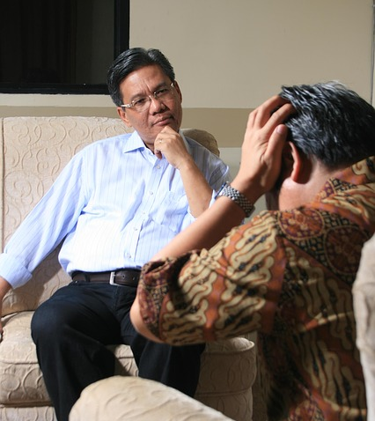
Treatment
How should anxiety disorders be treated?
What treatments work the fastest?
What treatments are most effective long term?
Notes:
This slide focuses on ways anxiety disorders can be treated.
Instructor’s note: Inform students that anxiety disorders are among the most treatable disorders. Next, help students use their intuition to discuss how anxiety disorders are treated by asking the following three questions.
Discussion:
(Click) How should anxiety disorders be treated?
Answer: Anxiety disorders can be treated by interrupting or changing the learning surrounding the anxiety disorder. This can be done through therapy or through medication.
(Click) What treatments work the fastest?
Answer: Medication (or biological treatments) will offer immediate relief by reducing or eliminating anxious symptoms (e.g., sweating, increased HR, etc.).
(Click) What treatments are most effective long term?
Answer: Medication is only effective as long as people keep taking the medication. Behavioral (or psychological) treatments take the longest to work, but have the best long-term outcomes. However, sometimes fears come back, especially if people don’t continue to “work on” or expose themselves to feared or anxiety producing stimuli.

Slide 23
Treatment: Fear Hierarchy of Dogs
10: Room with lots of dog toys
20: Smelling a dog
50: Hearing a dog
60: Seeing small dogs
70: Seeing big dogs that are not Golden Retrievers
90: Golden Retrievers
100: Sweetie the Golden Retriever
Sweetie!
Notes:
This slide illustrates a fear hierarchy that may be used to treat the fear of dogs created by a dog bite from Sweetie.
Instructor’s note: Describe the process in which patients develop a fear hierarchy of least feared but still somewhat anxiety provoking stimuli to most feared. During each level of the fear hierarchy patients are exposed to stimuli until it no longer produces anxiety.
(Click) 10: Room with lots of dog toys
(Click) 20: Smelling a dog
(Click) 50: Hearing a dog
(Click) 60: Seeing small dogs
(Click) 70: Seeing big dogs that are not Golden Retrievers
(Click) 90: Golden Retrievers
(Click) 100: Sweetie the Golden Retriever

Slide 24
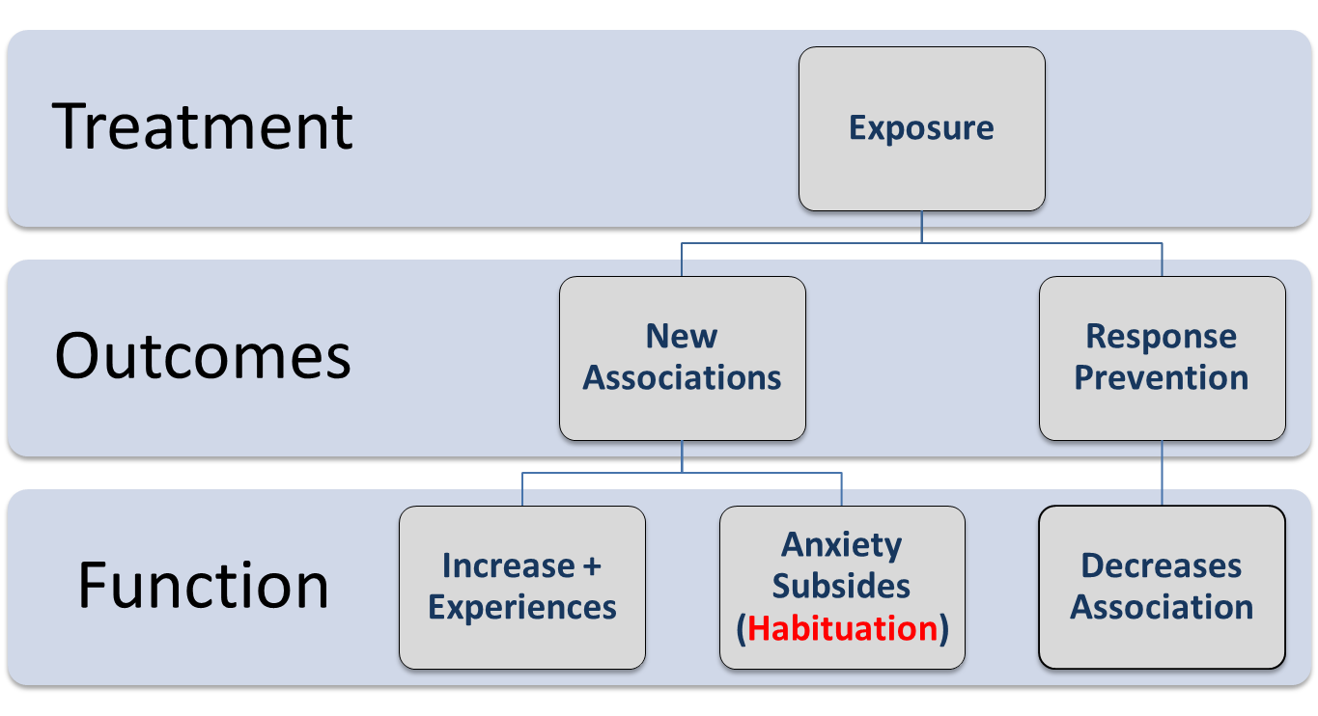
Applying Learning to Exposure Therapy
Notes:
This slide illustrates the process of exposure therapy in which patients create a fear hierarchy (shown on the previous slide). Then this hierarchy is applied at each level, moving from least to most feared stimuli.
Lecture info: Exposure therapy allows for new associations and prevents responses (avoidance or for OCD compulsive behaviors). New associations allow for increased positive experiences and eventual decreasing of anxiety as a result of habituation.
Preventing responses (either through escape prevention or preventing compulsion in OCD) then decreases the association between needing to avoid the feared stimuli or perform a behavior in response to anxiety provoking stimuli.
Discussion: Ask students to use the dog phobia example to describe how treatment would work at a specific place on the fear hierarchy (e.g., being exposed to big dogs that are not golden retrievers).
How could a therapist ensure that exposure to a big (but non-Golden Retriever) dog leads to increased positive experience?
Students may generate things like, ensure dog is nice, keep dog on leash, slowly decrease distance between person and dog.
How can a therapist ensure anxiety subsides?
Students may generate things like, continually asking people what their anxiety is at on a scale of 1-100.
Why is decreasing associations important?
People have sometimes spent their entire lives avoiding and reinforcing associations between anxiety and specific phobias. Thus it’s important to decrease and change associations.

Slide 25
Photo Attribution
Slide 1 and 13 | Photo Credit: Berhooz Nobakht https://www.flickr.com/photos/73633138@N00/1137484283 https://creativecommons.org/licenses/by-nc-nd/2.0/
Slide 3 | Photo Credit: zetson http://www.flickr.com/photos/66814335@N00/3241975525/ https://creativecommons.org/licenses/by-nc-sa/2.0/
Slide 6 | Photo Credit: be_khe http://www.flickr.com/photos/16118776@N00/2237614948/ https://creativecommons.org/licenses/by/2.0/
Slide 8 | Photo Credit: Hina :-) http://www.flickr.com/photos/86927238@N00/518430055/ https://creativecommons.org/licenses/by-nc-nd/2.0/
Slide 10 | Photo Credit: Geralt http://pixabay.com/en/keyboard-button-panic-fear-anxiety-114439/ http://pixabay.com/go/?t=%2Fservice%2Fterms%2F%23download_terms
Slide 11 | Photo credit: Josch13 http://pixabay.com/en/spider-arachnid-insect-close-348786/ http://pixabay.com/go/?t=%2Fservice%2Fterms%2F%23download_terms
Slide 12 and 23 | Photo Credit: Kaz http://pixabay.com/en/dog-golden-retriever-golden-164675/ http://pixabay.com/go/?t=%2Fservice%2Fterms%2F%23download_terms
Slide 15 | Photo Credit: Chesi - Fotos CC http://www.flickr.com/photos/19132040@N04/2513823044/ https://creativecommons.org/licenses/by-sa/2.0/
Slide 18 | Photo Credit: William Brawley http://www.flickr.com/photos/93841400@N00/4195919691/ https://creativecommons.org/licenses/by/2.0/
Slide 22 | Photo credit:tiyowprasetyo http://pixabay.com/en/counseling-stress-angry-99740/ http://pixabay.com/go/?t=%2Fservice%2Fterms%2F%23download_terms
Notes:
This slide illustrates the process of exposure therapy in which patients create a fear hierarchy (shown on the previous slide). Then this hierarchy is applied at each level, moving from least to most feared stimuli.
Lecture info: Exposure therapy allows for new associations and prevents responses (avoidance or for OCD compulsive behaviors). New associations allow for increased positive experiences and eventual decreasing of anxiety as a result of habituation.
Preventing responses (either through escape prevention or preventing compulsion in OCD) then decreases the association between needing to avoid the feared stimuli or perform a behavior in response to anxiety provoking stimuli.
Discussion: Ask students to use the dog phobia example to describe how treatment would work at a specific place on the fear hierarchy (e.g., being exposed to big dogs that are not golden retrievers).
How could a therapist ensure that exposure to a big (but non-Golden Retriever) dog leads to increased positive experience?
Students may generate things like, ensure dog is nice, keep dog on leash, slowly decrease distance between person and dog.
How can a therapist ensure anxiety subsides?
Students may generate things like, continually asking people what their anxiety is at on a scale of 1-100.
Why is decreasing associations important?
People have sometimes spent their entire lives avoiding and reinforcing associations between anxiety and specific phobias. Thus it’s important to decrease and change associations.

